Slide 1
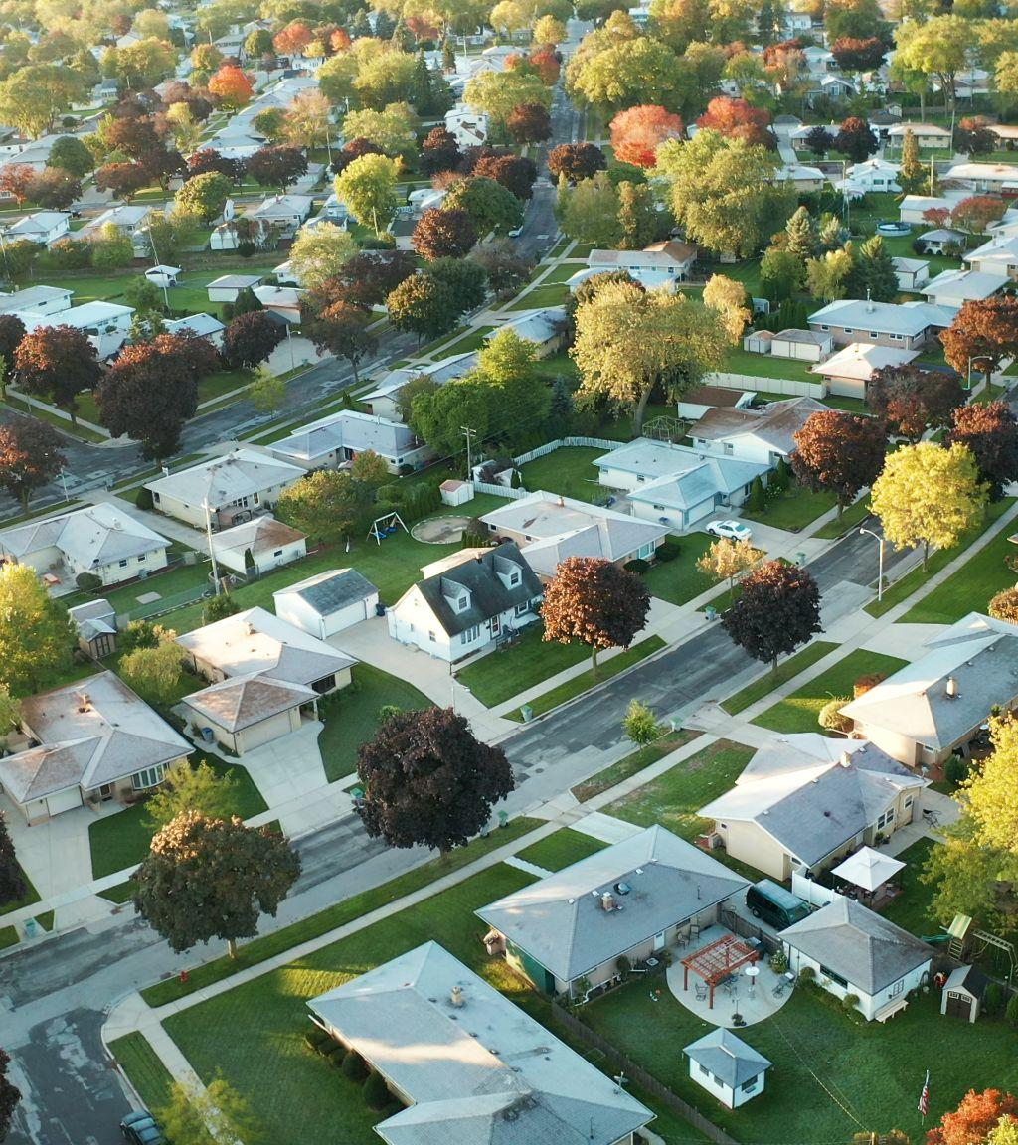

Best Practice: Wholesale Pricing in Open Access Networks

Slide 2

SERVICES =
MULTIPLE SERVICE PROVIDERS
What Type of Open Access?
“True” Lit Open Access
OPERATIONS =
ELECTRONICS AND PROVISIONING
INFRASTRUCTURE =
THE CONDUITS AND FIBER

Slide 3
SUBSCRIBERS
$
SERVICE PROVIDERS
How Does the Business Model Work?
Who is Paying Who?
$
NETWORK OWNER AND OPERATOR

Slide 4
SUBSCRIBERS
$
SERVICE PROVIDERS
How Does the Business Model Work?
Who is Paying Who?
$
NETWORK OPERATOR
$
NETWORK OWNER
“Network Lease”

Slide 5
SUBSCRIBERS
$
SERVICE PROVIDERS
How Does the Business Model Work?
Who is Paying Who?
NETWORK OPERATOR
$
$
NETWORK OWNER
“Outsourced Operations”

Slide 6

BEST PRACTICE 1
FIBER IS A
TAKE-RATE GAME!
MAKE SURE TO HAVE SOMETHING
FOR ALL CUSTOMERS

Slide 7

Best Practice 1:
What Should the ISP’s Sell?
5 GIG
1 GIG
250 MBps
$
$
$
$
$
$
$

Slide 8
75% Take-rate
70% Take-rate
45% Take-rate
55% Take-rate
65% Take-rate
Fiber ISP 2
Fixed Wireless
Fiber ISP 1
Best Practice 1:
Why is “Bronze” Important?
Mobile
Cable
Fiber ISP 5
Satellite
Fiber ISP 3
DSL
Fiber ISP 4
Many Don’t Understand Fiber
You Need an Entry Product!

Slide 9
BEST PRACTICE 2
PRICE PER SERVICE
NOT PER PIPE!

Slide 10
Accessline
bit-pipe
Service
bundl
$40
Best Practice 2:
Price Per Service and speed
Access line
Security
Telehealth
Smart meters
Internet (5 Gig, 1 Gig, 250 Mbps
bit-pipe
VOIP
$30- $125
IPTV

Slide 11
BEST PRACTICE 3
FIXED WHOLESALE FEES
NOT REVENUE SHARING

Slide 12
SUBSCRIBERS
$59-10%= $53.10
$59
SERVICE PROVIDERS
$45-10%= $40.50
Best Practice 3:
Fixed Wholesale Fees - not revenue sharing
$45
NETWORK OWNER AND OPERATOR
Service Provider Lost Margin: 14-12,60= $1.40
Owner/Operator Lost Margin: 45-40.50= $4.50

Slide 13
BEST PRACTICE 4
ONLY ONE MONTHLY BILL TO THE SUBSCRIBER

Slide 14
Best Practice 3:
One Bill to the Subscriber
SUBSCRIBERS
$15
$45
SERVICE PROVIDERS
Problems:
NETWORK OWNER AND OPERATOR
- Twice as many bills (inefficient)
- Who do you call when you have a problem?
- What if one bill gets payed, not the other?
- What is a “network fee”?

Slide 15
MILLION DOLLAR QUESTION
HOW MUCH SHOULD EVERYONE GET?

Slide 16
SUBSCRIBERS
Million Dollar Question
How Much Should Everyone Get?
$ 65
SERVICE PROVIDERS
$ 45
Considerations:
NETWORK OPERATOR
- Cost to build? Who pays for what?
- Competition?
$ 15
- Goal with the build (muni vs private)?
NETWORK OWNER
- High take-rates should be the initial goal for all!

Slide 17
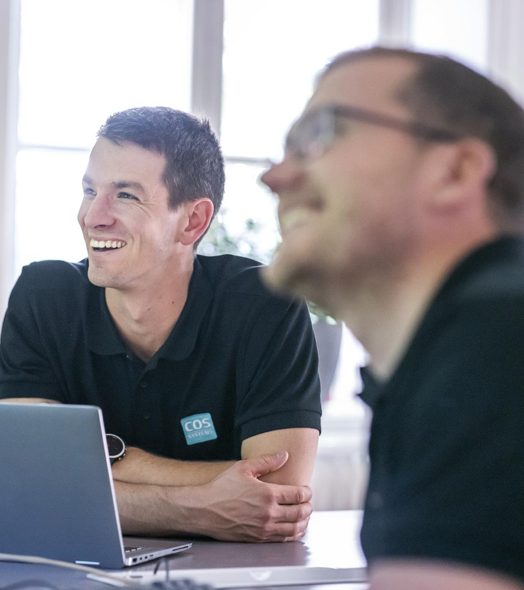
Thank you for your
Time and Attention!
sales@cossystem.com
Bjorn is eating a burger at
Fat Smittys in Port Townsend.

